Slide 1
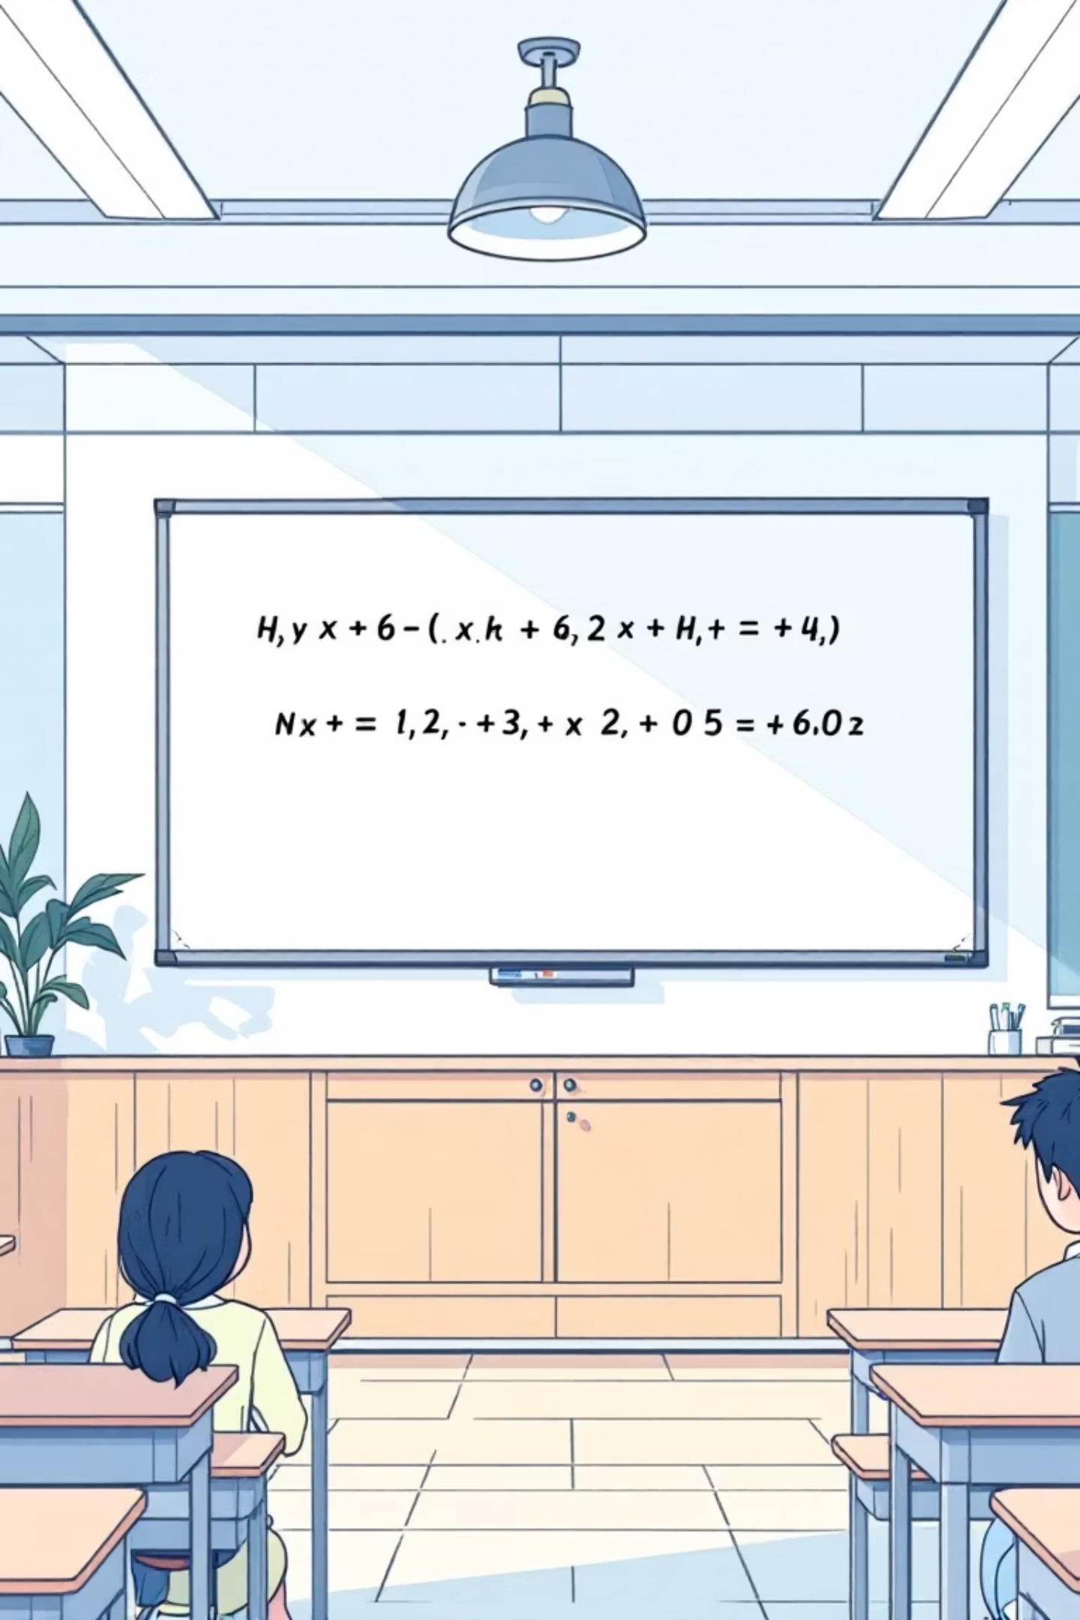
Comparison of Deep Learning Architectures for Handwritten Math Symbol Recognition

Slide 2

Introduction and Overview
Handwritten math symbol recognition powers advanced applications in education, research, and AI-driven equation solvers. This analysis compares six architectures—YOLOv8, GoogLeNet, AlexNet, EfficientNet, ResNet, and VGG16—trained on a specialized dataset of symbol images. Evaluation focuses on accuracy, efficiency, and adaptability for classification tasks.
01
02
Dataset Preparation
Model Training
Custom collection of handwritten symbols, emphasizing diverse styles and variations for robust training.
Architectures fine-tuned with transfer learning where applicable, using CPU/GPU resources.
03
Performance Metrics
Key indicators: accuracy, precision, recall, and F1-score on validation and test sets.

Slide 3
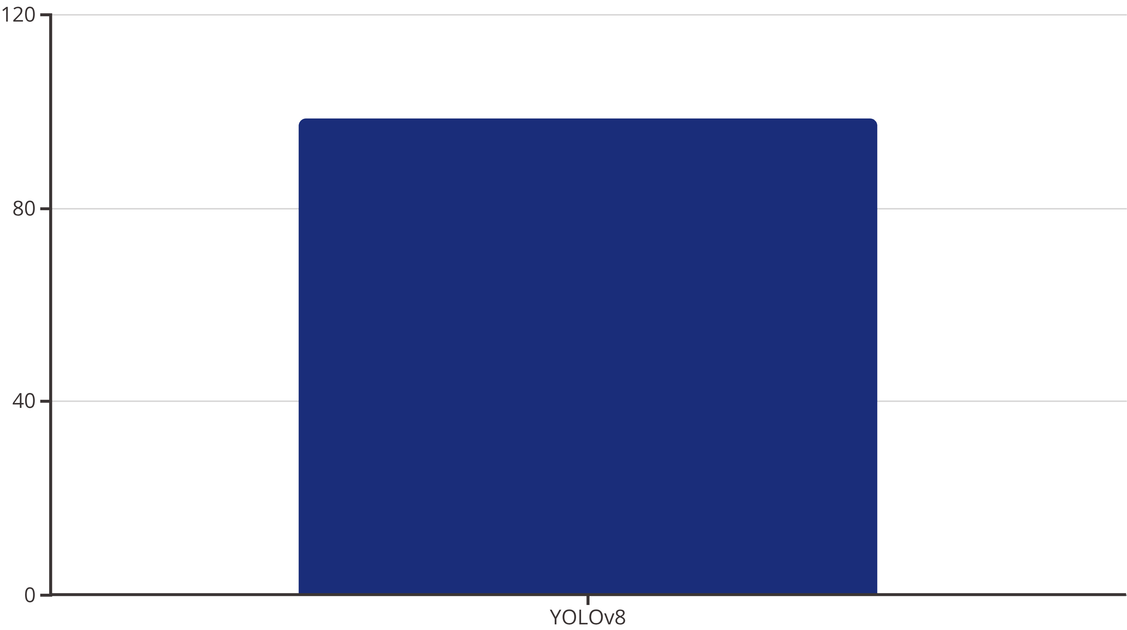
YOLOv8 Architecture
YOLOv8-cls, an evolution from object detection roots, excels in real-time processing. Trained for 20 epochs on handwritten math symbols using CPU, it demonstrates remarkable adaptability to pure classification.
Key strength: High accuracy with minimal epochs, ideal for resource-constrained environments. Limitations: Lacks detailed precision/recall due to simplified reporting.

Slide 4
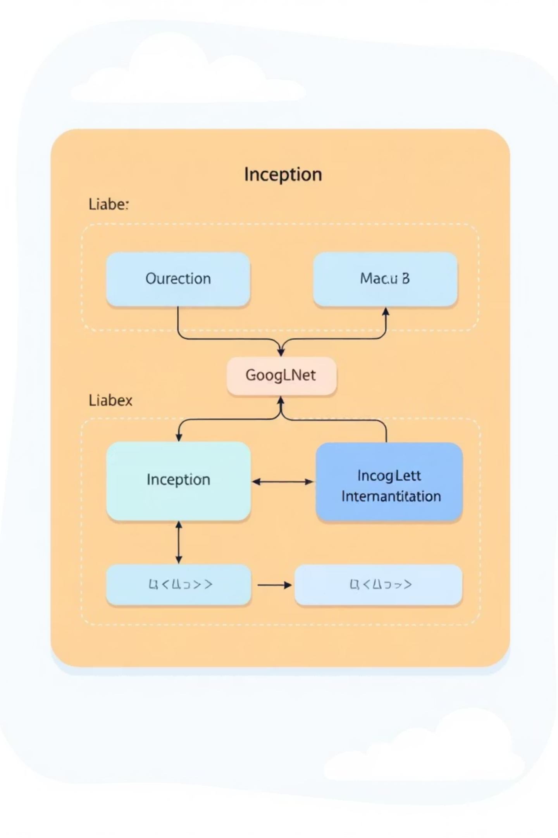
GoogLeNet: Inception Efficiency
GoogLeNet leverages Inception modules for multi-scale feature extraction, promoting computational efficiency. Trained for 7 epochs on the symbol dataset, it balances depth and speed without excessive parameters.
Performance Metrics
Detailed Scores
Validation Accuracy: 91.93%
Precision (macro avg): 0.92
Test Accuracy: 92.19%
Recall (macro avg): 0.92
F1-score (macro avg): 0.92
Observations: Strong equilibrium in precision and recall, making it suitable for datasets with class imbalances in math symbols.

Slide 5

AlexNet: Classic Simplicity
AlexNet, a foundational CNN, uses large kernels and ReLU activations for rapid convergence. Trained for just 3 epochs, it was tested across input variants: RGB, binary, edge, gradient magnitude, and direction.
RGB Variant (Best Performer)
Validation Accuracy: 97.22% | Precision: 0.95 | Recall: 0.95 | F1: 0.95
Key Insight
RGB inputs yield superior results, highlighting the value of color-enhanced preprocessing for handwritten symbols.
Test Accuracy reached 95%, underscoring AlexNet's efficiency for quick prototyping in classification pipelines.

Slide 6

EfficientNet: Balanced Scaling
EfficientNet-B0 employs compound scaling across depth, width, and resolution for optimal performance-efficiency trade-offs. Trained for 15 epochs with ImageNet transfer learning on the symbol dataset.
Metrics Overview
Advantages
Validation Accuracy: 96.80%
Transfer learning accelerates convergence; ideal for mobile or edge deployment in math recognition apps.
Test Accuracy: 96.93%
Precision/Recall/F1 (macro avg): 0.97
Excels in handling variable symbol complexities without overfitting.

Slide 7

ResNet: Residual Learning
ResNet-18 mitigates vanishing gradients via skip connections, enabling deeper networks. Trained for 15 epochs with ImageNet pre-training, it processes handwritten symbols with high fidelity.
96.40
96.60
0.97
Validation Accuracy (%)
Test Accuracy (%)
Precision/Recall/F1
Consistent performance across epochs, leveraging residuals for stable training.
Robust generalization to unseen symbol variations.
Macro averages indicate balanced class handling in math datasets.
Suits research scenarios requiring depth without complexity overhead.

Slide 8
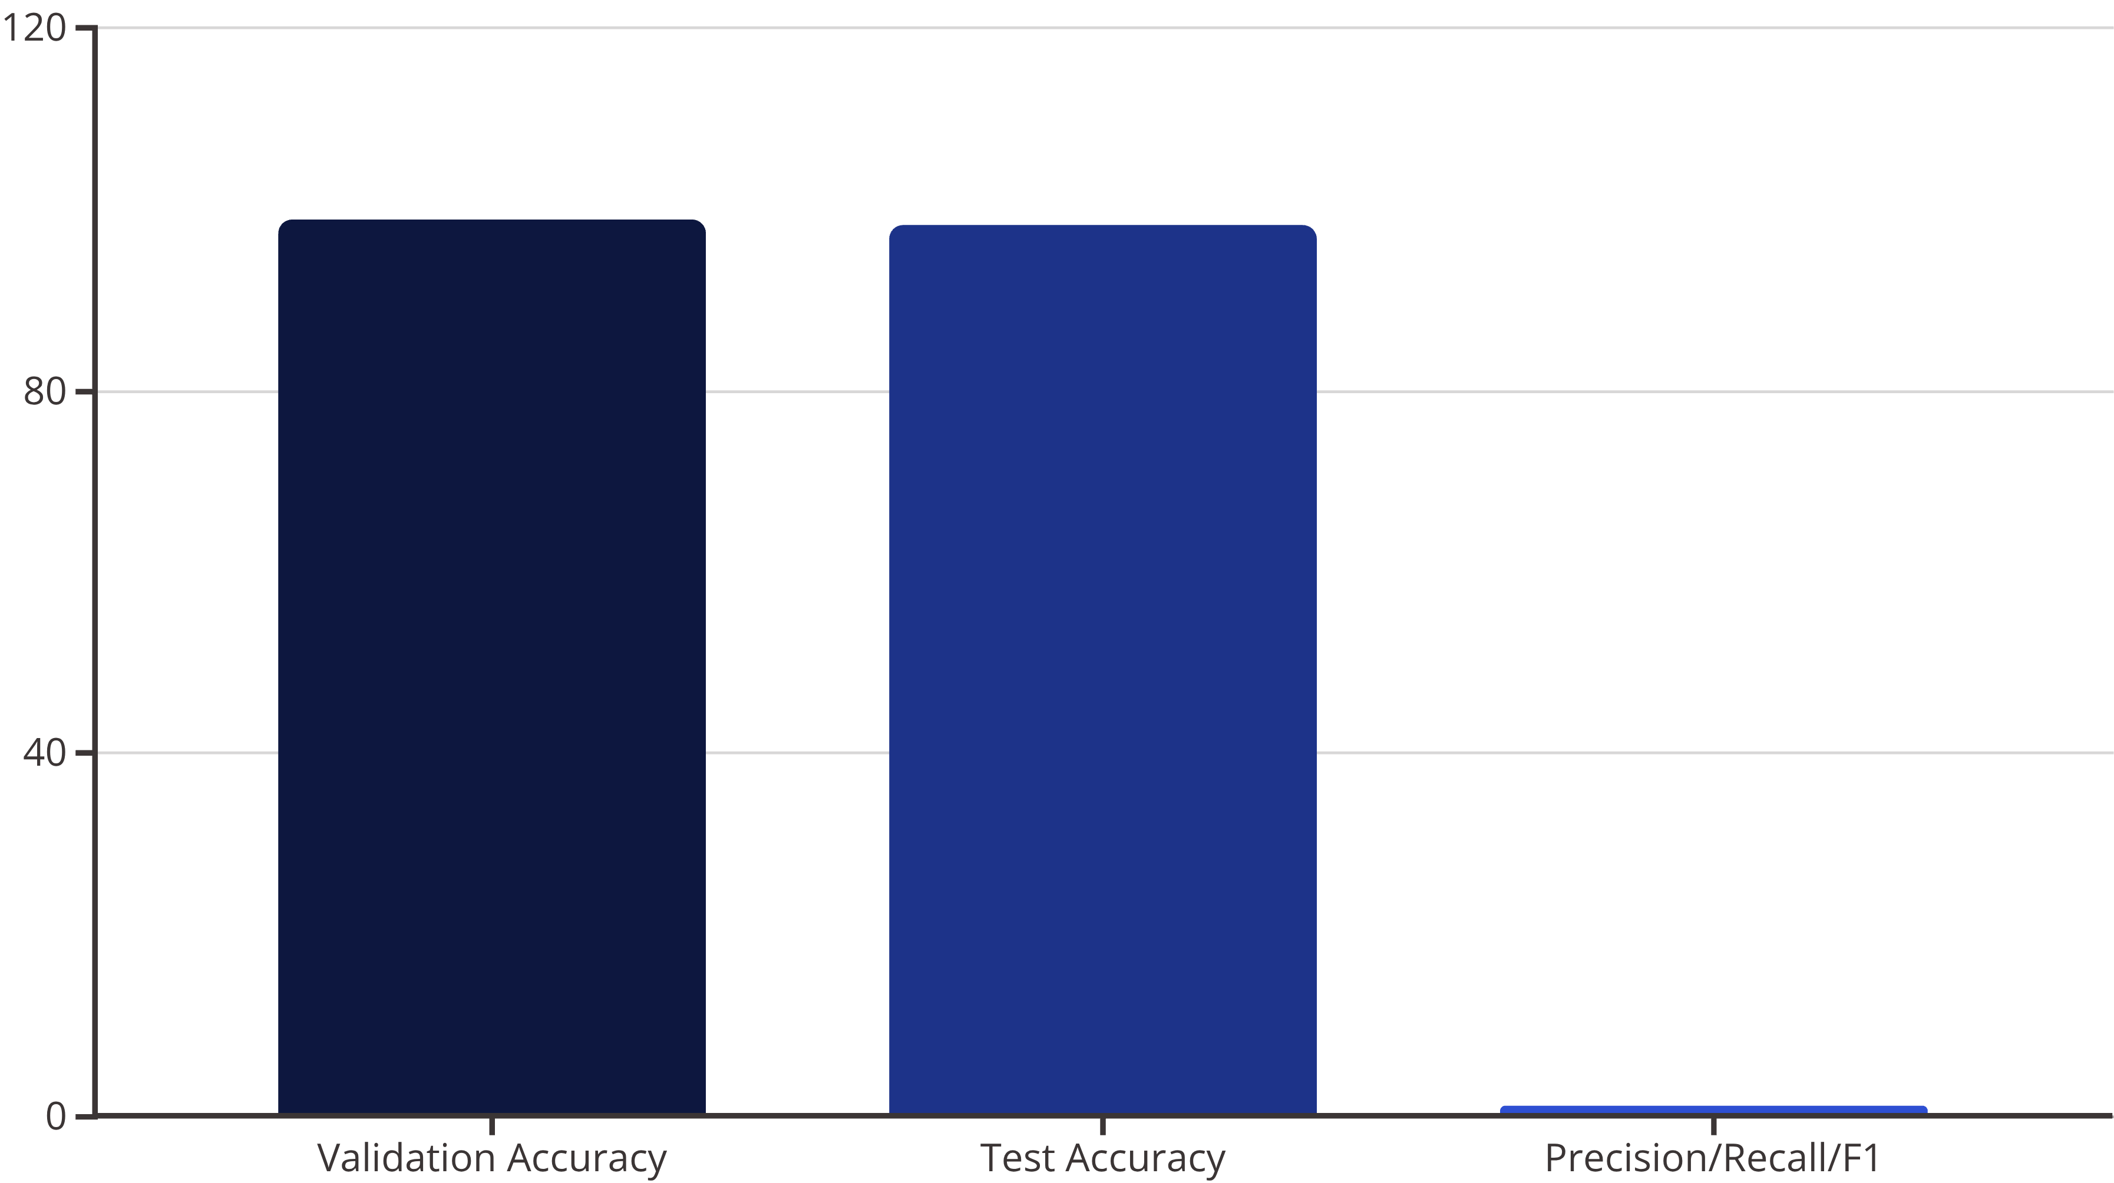
VGG16: Depth with Simplicity
VGG16's uniform 3x3 convolutions build depth progressively. Training halted at 19 epochs via early stopping, achieving top metrics on the symbol dataset.
Key: Highest accuracies among peers; simple design aids interpretability in symbol feature extraction.

Slide 9
Performance Comparison Summary
Aggregated results reveal VGG16 as the accuracy leader, with YOLOv8 close behind. EfficientNet and ResNet offer efficiency, while AlexNet shines in speed.
Architecture
Val Acc (%)
Test Acc (%)
Precision
Recall
F1-Score
YOLOv8
N/A
98.7
N/A
N/A
N/A
GoogLeNet
91.93
92.19
0.92
0.92
0.92
AlexNet
97.22
95.00
0.95
0.95
0.95
EfficientNet
96.80
96.93
0.97
0.97
0.97
ResNet
96.40
96.60
0.97
0.97
0.97
VGG16
99.00
98.36
0.98
0.98
0.98

Slide 10


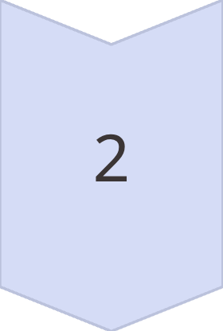
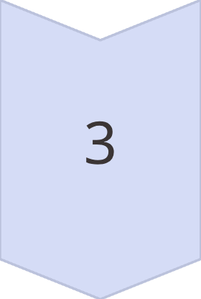
Key Takeaways and Recommendations
Top Performer: VGG16
Leads with 99% validation accuracy; choose for precision-critical tasks despite higher compute needs.
Efficiency Pick: EfficientNet
Balances speed and 97% metrics; ideal for deployment in real-time math recognition systems.
Quick Start: AlexNet
97% accuracy in 3 epochs; great for prototyping and input variant experimentation.

Slide 11
Thank You
Keshavramprakash.D
CB.SC.U4CSE23425
Ashwin VA
CB.SC.U4CSE23005
Radha Krishna
CB.SC.U4CSE23143
J.Yashwanth
CB.SC.U4CSE23622
Paggilla Saketh
CB.SC.U4CSE23343
Aditya Reddy
CB.SC.U4CSE23707

